Slide 1

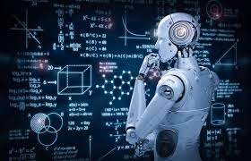
Machine Learning - Power that is beyond imagination
Supraja Rapuru

Slide 2
Agenda
What is Machine learning?
Why it is important?
How does it work?
Types of Machine Learning?
Business Applications
Advantages & Disadvantages
Ethical Challenges

Slide 3
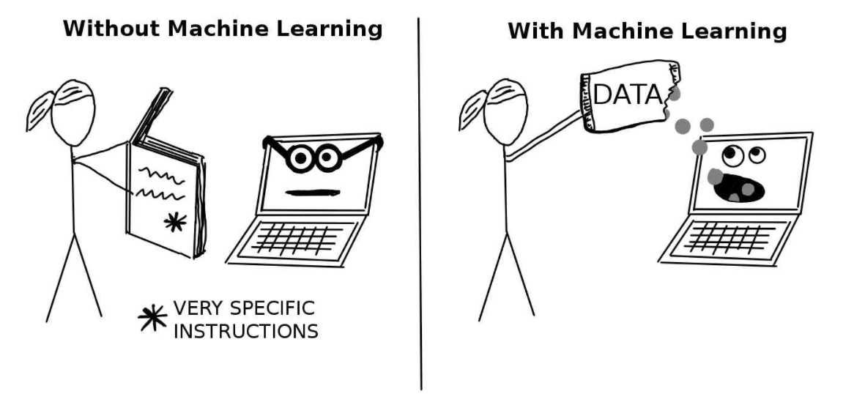
What is Machine Learning?
Machine learning is a sub field of artificial intelligence, which is broadly defined as the capability of a machine to imitate intelligent human behavior without being explicitly programmed. With “normal” software, we tell the computer what to do. With machine learning, we tell the computer how to figure out the answer itself, using the data we feed it.

Slide 4
Why it is important?
With an exponential increase in data, there is a need for having a system that can handle this massive load of data.
Some tasks can not be defined well except by examples (Image processing, Facial recognition etc)
The amount of knowledge available for certain tasks might be too large for explicit encoding by humans (Medical, diagnostic etc)
New knowledge about tasks is constantly being discovered by humans. It may be difficult to continuously re-design systems by hand.
Source: KPMG

Slide 5
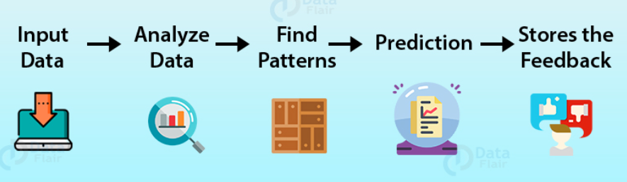
How does it work?
These machine learning algorithms use the patterns contained in the training data to perform classification and future predictions. Whenever any new input is introduced to the ML model, it applies its learned patterns over the new data to make future predictions.
Based on the final accuracy, one can optimize their models using various standardized approaches.
In this way, Machine Learning model learns to adapt to new examples and produce better results.

Slide 6
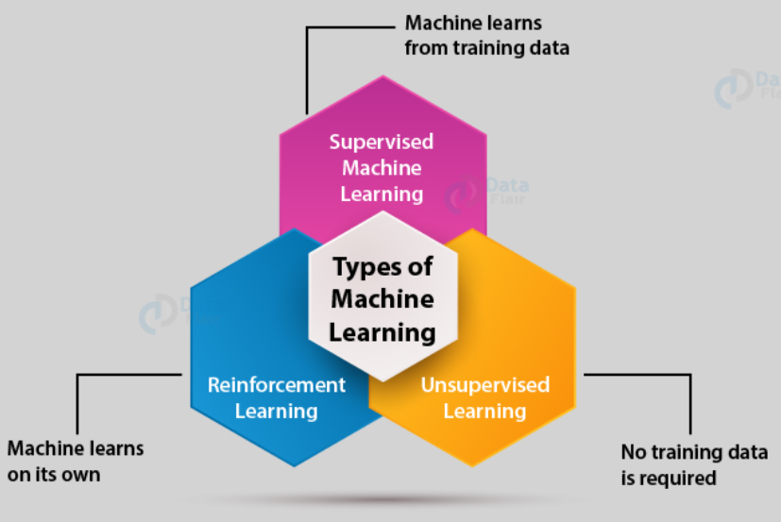
Types of Machine Learning?
Supervised learning is the most hands-on approach to machine learning. You give a program a datasets that has a bunch of values and the expected result you get from those values. It’s data to train the algorithm.
Unsupervised learning is more hands-off. You give the program a datasets, but no instructions on what the datasets means. You’re not defining any kind of outcome for the algorithm. Instead, it needs to figure out the patterns (if there are any) for itself.
Humans learn from trial and error. Reinforcement machine learning works in much the same way. A program is given data and the ability to test different events with different outcomes. It then stores those outcomes and tries to optimize itself to get the best result possible.

Slide 7
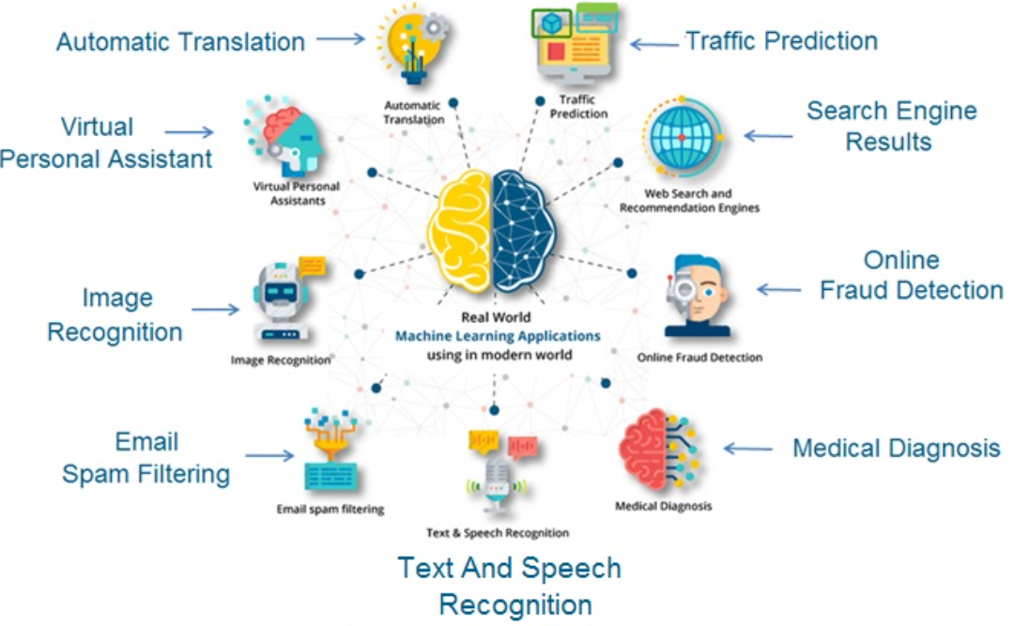
Business Applications
Medical Sector - ML helps in predictions and analysis and classification. In classification, it classifies the disease is normal or dangerous. Cancer predictions use both ML and Deep Learning. Heart monitoring, retinal scan, etc. is also possible using ML.
Speech Recognition: The sound model processes the sounds it hears and filters out words. The linguistic model tries to match the sound of the word with similar words. This helps to distinguish between similar-sounding words. Our mobile phones use speech recognition as well. Alexa, Siri, Google Home etc are driven by ML algorithms.

Slide 8
Advantages & Disadvantages
Advantages | Disadvantages
Easily identifies Trends and Patterns - ML can review large volumes of data and discover specific trends and patterns that would not be apparent to humans | Data Acquisition - Requires massive data sets to train on, and these should be inclusive/unbiased, and of good quality.
No Human intervention needed - Machines have the ability to learn, it lets them make predictions and also improve the algorithms on their own | Time and Resources - ML needs enough time to let the algorithms learn and develop enough to fulfill their purpose with a considerable amount of accuracy and relevancy
Continuous Improvement - As ML algorithms gain experience, they keep improving in accuracy and efficiency. | Interpretation of Results - the ability to accurately interpret results generated by the algorithms. You must also carefully choose the algorithms for your purpose.
Handling multi-dimensional and multi-variety data - ML algorithms are good at handling data that are multi-dimensional and multi-variety, and they can do this in dynamic or uncertain environments | High error-susceptibility

Slide 9
Ethical Challenges
There are some ethical challenges that Machine Learning presents:
Digitization of cultural prejudices on use of systems trained on biased datasets (algorithmic bias)
Training of machines on languages corpora that contain biases
The possibility that these systems in the health care field might be designed not in public interest, but to boost income
While Machine Learning can prove to be really effective in improving health care, these ethical questions must be addressed first.

